Slide 1

Accounting for Capital Assets
Gary H. Mitchell, CPA
Vice President

Slide 2
Learning Objectives:
Overview of capital asset valuation and accounting
Identify policies and procedures related to capital assets
Understand the importance of internal controls related to capital assets

Slide 3

Capital Assets - Definition
Largest asset of a local government.
Tangible and intangible assets acquired for use in operations that benefit the local government for more than a single fiscal period.
Local governments should report only those capital assets that they own.
Leases, although now accounted for under GASB 87, should be subject to make of the same internal controls as capital assets

Slide 4


Capital Assets - Definition
Examples include:
  Land
  Land improvements
  Construction-in-progress
  Infrastructure/Improvements
  Buildings
  Furniture
  Motor vehicles
  Audio-visual
  Software

Slide 5
Capital Asset Valuation
Capital assets should be reported at their historical cost to purchase or construct the asset, which can include:
  all charges to place the asset in its intended location (for example, freight);
  all charges to place the asset in its intended condition for use (for example, installation or site preparation); and,
  subsequent additions or improvements that enhance a capital asset’s functionality or extend its expected useful life.

Slide 6

Acquisition Costs
Pre-conditions for capitalization:
  Capitalize a cost only if it is directly identifiable with a specific asset.
  Capitalize a cost only if incurred after acquisition of the related asset is considered probable.

Slide 7
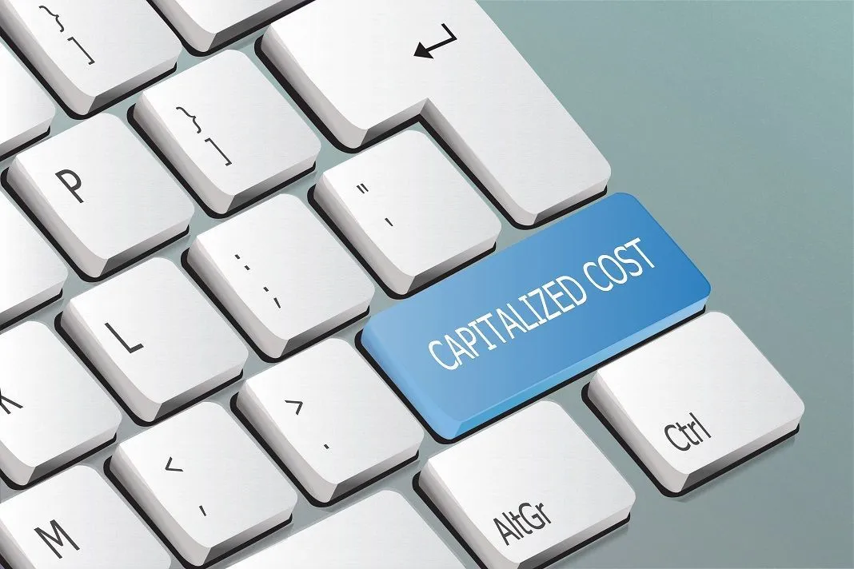
Capitalizable Costs
Internal costs
  General and administrative costs should never be capitalized
    Overhead (e.g., use of office facilities, executive management, accounting, human resources)
  Costs directly related to the acquisition of a specific asset should be capitalized (e.g., salaries specific to a construction project)

Slide 8

Training
Should not be capitalized for two reasons:
  Does not affect the intended location and condition for use
  Does not provide benefit throughout the useful life

Slide 9
Improvements or Repairs
Improvements
  Lengthen a capital asset’s estimated useful life; or,
  Increase a capital asset’s ability to provide service (i.e., greater effectiveness or efficiency)
Improvements should be capitalized and recognized as depreciation expense over the estimated useful life of the asset.
Repairs and maintenance
  Retain value rather than provide additional value
Expenditures for repairs are generally not included in historical cost.

Slide 10

The Grey Areas
Care is sometimes needed
to distinguish actions that
lengthen the useful life of an
asset from those that merely
avoid shortening it.

Slide 11
Capital Outlay or Period Cost?
What is the Paving of an Existing Dirt Road Considered to be?
What is the Expansion of an Existing Reservoir Considered to be?
What is the Draining & Re-Piping of Dam on an Existing Reservoir Considered to be?
What is a Paint Job on a Building Considered to be?
What is a New Roof on a Building Considered to be?
What is Road Re-Surfacing Considered to be?

Slide 12

Valuation of Capital Assets
Initial Valuation:
Purchased - assets acquired through purchase or construction should be reported at their historical cost
Donated - assets acquired for a nominal amount should be handled as a donation for accounting purposes rather than at the actual/nominal cost.

Slide 13

Valuation of Capital Assets
No Cost Known = Estimating Historical Cost:
Direct Costing -for particularly long-lived assets, the detailed documentation needed for direct costing may no longer be available, or impractical to access
Two methods are available for estimating historical cost:
  Standard Costing, or
  Normal Costing (Back-Trending)

Slide 14
Donated Capital Assets
Capital Assets acquired through Donation:
Donated capital assets should be reported at their estimated fair value at the time of acquisition:
  Fair Value is what the government would have had to pay to acquire the asset on its own.
Donations of infrastructure (roads, utilities, etc.), value determined by:
  Cost of government to construct the road; or
  Developer’s cost.

Slide 15
Capital Asset Capitalization and Accountability
Any asset that benefits more than one fiscal period potentially could be classified as a capital asset.
As a practical matter, not all items that meet the definition of a capital asset should be capitalized for reporting purposes.
Local government officials should establish a dollar value or capitalization threshold that capital assets must exceed if they are to be capitalized. Discussed in the next section.

Slide 16
Capital Asset Capitalization and Accountability
Other considerations, as recommended by the Government Finance Officers Association (GFOA), include:
  Items capitalized should have an estimated useful life of at least two years from the date of acquisition;
  Capitalization thresholds are best applied to individual items rather than to groups of similar items unless the effect of doing so would be to eliminate a significant portion of total capital assets (e.g., books of a library district);
  Capitalization thresholds should not be set at less than $5,000 for any individual item; and,
  Governments that are recipients of Federal awards should be aware of Federal requirements that prevent the use of capitalization thresholds in excess of certain specified maximum amounts (currently $5,000) for purposes of Federal reimbursement.

Slide 17
Capital Asset Capitalization and Accountability
When capital assets are not capitalized, governments should still ensure that adequate control and accountability is maintained, especially in certain circumstances, such as:
  For those local governments subject to Tennessee Department of Education rules, “sensitive minor equipment” with a value or cost of $100 or more and a projected useful life of one year or more is required to be recorded for inventory purposes.
  Assets that pose a risk to public safety and could be the source of potential liability (weapons, etc.).
  Assets that must be accounted for pursuant to a legal or contractual provision.
  Assets that are easily transportable and readily marketable or easily diverted to personal use (Computers, tablets, etc.).

Slide 18
Capital Asset Capitalization and Accountability
Many governments use a perpetual inventory system to maintain effective control over capital assets. Such a system is constantly updated for additions and deletions of the capital assets inventory. Periodic verification is still required to ensure adequate control and accuracy of the government’s inventory.
GFOA recommends that governments inventory its tangible capital assets, at least on a test basis, no less than every five years.
As mentioned, for those local governments subject to Tennessee Department of Education rules and Federal Grants/Uniform Guidance, an inventory is required for property with a cost or value of $1,000 at least semi-annually.

Slide 19
Depreciation of Capital Assets
Capital assets should be depreciated over their estimated useful lives unless they are:
  inexhaustible,
  intangible assets with indefinite useful lives, or
  are infrastructure assets using the modified approach as set forth in this section.
Inexhaustible assets such as land and land improvements should not be depreciated.
Also, construction in progress is not depreciated until placed in service.

Slide 20
Depreciation of Capital Assets
The systematic and rational allocation of the cost of a capital asset over its estimated useful life.
Local government officials need to establish the useful life and depreciation method for each class of capital asset.
  Straight-line depreciation is the most common method.
  The composite depreciation method is applied to a certain type of capital asset rather than to an individual capital asset.

Slide 21
Depreciation of Capital Assets
Past experience should be used to determine the estimated useful life of an asset. When the government has no past experience to rely upon, the experiences of other governments can be useful. However, when depending on others’ experiences, the government should take into consideration:
  differences in quality of materials that comprise the asset
  differences in the extent of use or the intended uses of the asset
  environmental differences between assets held by others and those acquired by the government
Once established, estimated useful lives should be periodically compared to actual experiences to make adjustments as necessary. (Hint – large gains or losses on disposal)

Slide 22
Capital Asset Reporting
Governmental Accounting Standards Board, Statement 34, requires capital assets to be reported on the government-wide Statement of Net Position and in the Notes to Financial Statements.
Each local government must make four distinctions:
  Capital assets related to governmental activities that must be reported separately from those related to business-type activities.
  Different major classes of capital assets.
  Capital assets that are not being depreciated.
  Accumulated depreciation.

Slide 23
Capital Asset Reporting
In addition, the following must also be reported:
  The historical cost of capital assets (or their fair value at the time of donation)
  Accumulated depreciation
  Additions during the period – Deletions during the period
The format of the disclosure must demonstrate the change between the beginning and ending book values.

Slide 24
Statements of Principle Reporting Capital Assets
A clear distinction should be made between general capital assets and capital assets of proprietary and fiduciary funds.
Capital assets of proprietary should be reported in both the government-wide and fund financial statements.
Capital assets of fiduciary funds (and similar component units) should be reported only in the statement of fiduciary net position. All other capital assets of the governmental unit are general capital assets. They should not be reported as assets in governmental funds but should be reported in the governmental activities column in the government-wide statement of net position.

Slide 25
Policies and Procedures
Understand the operational aspects of capital outlay

Slide 26
System Design and Policies
A capital asset system is essential to ensure that all the necessary data is collected and kept current.
Asset listing can not only include items reported in financial statements, but also items not capitalized but for which information needs to be maintained to:
  Ensure legal compliance
  Compensate for a heightened risk of theft

Slide 27

Capital Asset Policies
Capital asset policy approved by the governing body
GASB does not provide specific policy information
When establishing the capital asset policies,
one should consider the questions
on the following slides:

Slide 28

Setting Policies - Thresholds
Single capitalization threshold or different thresholds for different classes
What will be the capitalization threshold
How will capitalization thresholds be applied (individual or group)

Slide 29

Setting Policies - Components
How should discrete components of larger assets be treated? Cost of a component can be:
  Treated as a separate capital asset (preferable, but rarely done in practice). This is also known as “cost segregation”; or,
  Included in the cost of the larger asset, with the component’s eventual replacement treated as a repair.

Slide 30

Setting Policies - Donations
How and when do you determine a donation has occurred?
How should fair value be determined for donated capital assets?
  What methodology will be used?
  How do you determine fair value?
  Who will be charged with making and documenting estimated of fair value?

Slide 31
Setting Policies – Major Classes
What major classes of capital assets should be used?
What will the Major Classes be?
  Land
  Buildings, Improvements (Fences, etc.), Furnishings & Equipment, Infrastructure, Construction in Progress, Other…..
Which specific items will be reported in each class?

Slide 32
Setting Policies – Depreciation
Which items should be depreciated or amortized and how?
Capital assets must be depreciated or amortized unless they have an indefinite useful life:
  Land
  Construction in Progress
  Networks or subsystems of infrastructure assets for which the government has qualified for, and elected to use the modified approach

Slide 33
Setting Policies – Depreciation
Will useful lives be estimated for individual assets or major classes?
What will be the basis for those estimates?
How will the reasonableness of estimates be evaluated on an ongoing basis?
What method will be used to calculate depreciation?
Will depreciation be applied to individual (component) items or groups of items?
How will depreciation be applied to partial years?

Slide 34
Setting Policies – Impairments
What is an impairment?
A decline in service value that must be both of the following:
  Significant (in relation to its utility)
  Unexpected (not foreseeable)
The decline must be permanent, and not temporary.
  School is 5 years old => to be used as storage for a year?
  School is 5 years old => to be used as storage forever?
Burden of proof on the government to prove it is temporary

Slide 35
Setting Policies – Impairments
Events or circumstances should be prominent?
Discussions by governing board, management and media. Examples:
  Physical damage;
  Changes in laws, regs., or environmental factors that affect service utility;
  Technological advances that cause decline of demand = obsolescence;
  Change in manner or duration of use of the asset;
  Stoppage of construction or development.

Slide 36
Setting Policies – Control
How should disposals be handled?
Who can authorize a disposal?
What procedures are followed to ensure the gov’t receives maximum benefit from the disposal?
How often should physical inventory be performed?
Establish an inventory cycle, rotating among departments each year
Determine who will be responsible for performing the inventory.

Slide 37

Setting Policies – Control
Which capital assets should be tagged?
Which items will a unique identification number be necessary?
Where will tags be placed on each type of property item?
Who will be responsible for tagging?

Slide 38
Setting Policies – Control
How should control be maintained over items that were not capitalized?
How will departments ensure that there is proper control over such items?
How will the central accounting function ensure that departments are doing this?

Slide 39

Setting Policies – Control
What about a physical inventory?
How often will physical inventories of capital assets be performed?
Who will be responsible for performing the inventories?

Slide 40
Internal Control related to
Capital Outlay
Understanding how to safeguard these assets

Slide 41
Why are Internal Controls related to Capital Assets Important?
Capital Assets =
large investment
of public dollars

Slide 42
Control Objectives for Internal Controls
Control operations
    Establish levels of authority for approval of transactions
    Adequate reporting system for approvers to monitor
Safeguard assets
    Waste, inefficiency, error, theft or fraud

Slide 43
Control Objectives for Internal Controls
Provide timely and reliable information
    Supports control structure
Compliance
    Knowledgeable about laws to follow
    Educate employees
    Monitor to ensure compliance

Slide 44
Capital Asset I/C Objective Steps:
Purchases properly authorized by management and for business purpose.
Purchases recorded timely and accurately
    Source documents
    Accounting records

Slide 45
Capital Asset I/C Objective Steps:
Maintain detailed subsidiary records
    Reconcile with control accounts
Physical inventory
    Existence
    Condition

Slide 46
Capital Asset I/C Objective Steps:
Report and account timely for
    Transfers, retirements, gains/losses
Maintain records accurately
Adequate segregation of duties

Slide 47
Risk Assessment – Objective 1
Purchases properly authorized by management and for business purpose.
Risk: Unauthorized purchases of capital assets are made or are not for valid business purposes.

Slide 48
Risk Assessment – Objective 2
Capital asset acquisitions should be recorded timely and accurately in source documents and accounts records.
Risk: Capital assets not recorded in the period purchased. Not recorded in proper amount or to proper account.

Slide 49
Risk Assessment – Objective 3
Detailed subsidiary records maintained for individual capital assets and reconciled to control accounts.
Risk: Purchase is not recorded in asset management system. Reconciliation between subsidiary ledger and control accounts should catch those items.

Slide 50
Risk Assessment – Objective 4
Periodic physical verification should be made of the existence and condition of property.
Risk: is that capital assets are in subsidiary ledger and on general ledger that the government no longer has/ or condition of asset has deteriorated.

Slide 51
Risk Assessment – Objective 5
Issues, transfers, retirements, and losses should be reported and accounted for timely.
Risk: Capital assets have been sold/scrapped and proper accounting not made for gains/losses or disposition of assets.

Slide 52
Risk Assessment – Objective 6
Capital asset records should be accurately maintained.
Risk: Capital asset records do not accurately reflect the physical capital assets.

Slide 53
Risk Assessment – Objective 7
Adequate segregation of duties in the capital asset function.
Risk: Inadequate segregation of duties allows for fraud and/or innocent errors not likely to be found and corrected.

Slide 54

Monitoring and Capital Assets
Are controls operating as intended?
Unmonitored controls deteriorate over time.
Internal Controls must be monitored on a regular basis to ensure that all controls are operating efficiently and effectively to prevent or detect and correct misstatements.

Slide 55
Questions?

